Slide 1
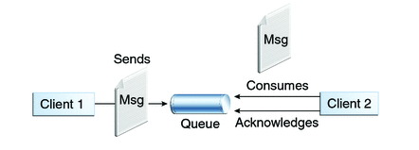

SpringBoot + JMS + RabbitMQ+AWS example
Queues [point-to-point]: Queue’s are based on point-to-point messaging model where messages are sent to a queue. Each message has exactly one sender and one receiver. Message is guaranteed to be delivered to only one receiver.
SpringBootJMSProducer Application
c
SpringBootJMSReceiver Application

Slide 2
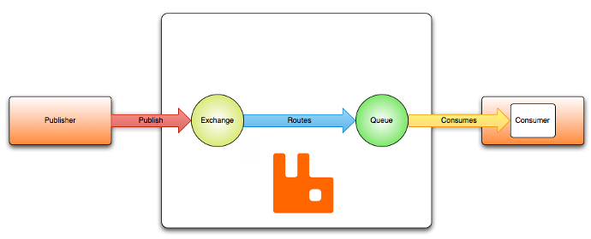
SpringBoot + JMS + RabbitMQ+AWS example
Routes the message to a queue
This is container for the messages.
SpringBootJMSProducer Application
c
SpringBootJMSReceiver Application

Slide 3
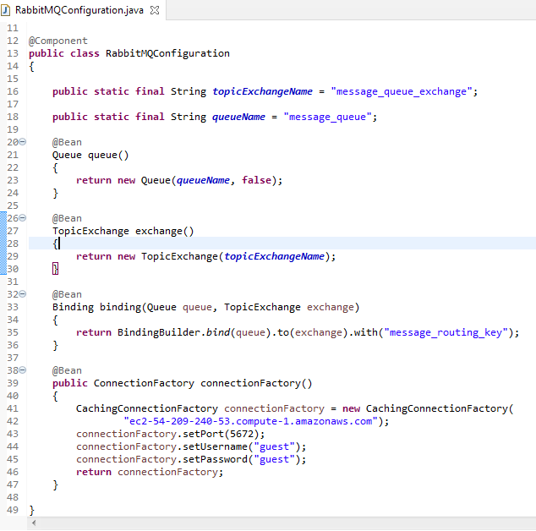
SpringBoot JMSProducer Application
Binding: Binds the queue and topic exchange for a given queue name.

Slide 4
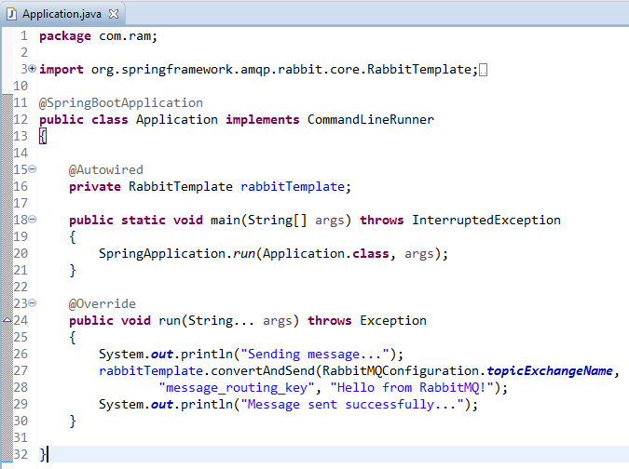
SpringBoot JMSProducer Application
Spring Boot automatically creates a connection factory and a RabbitTemplate, reducing the amount of code you have to write.
RabbitTemplate.convertAndSend method converts java object to AMQP message and is send to default topic exchange.

Slide 5
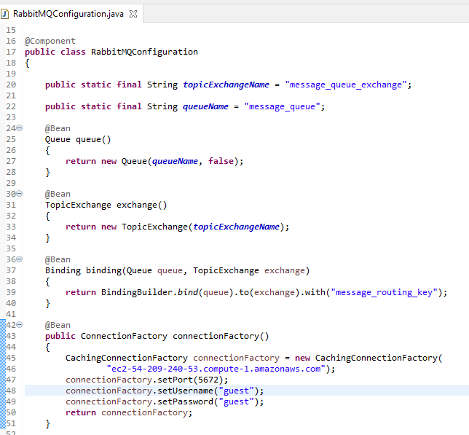
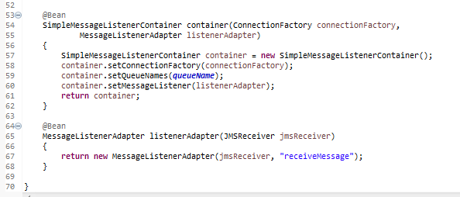
SpringBoot JMSConsumer Application
Register a Receiver with the message listener container to receive messages.

Slide 6
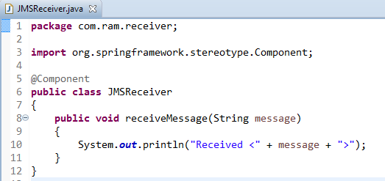
SpringBoot JMSConsumer Application
JMSReceiver class that will receive the message.

Slide 7
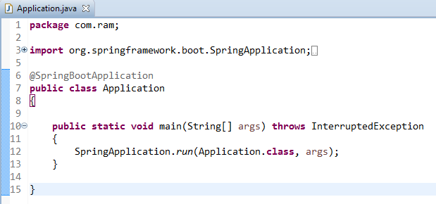
SpringBoot JMSConsumer Application

